Slide 1
KillingFrenzy

Slide 2
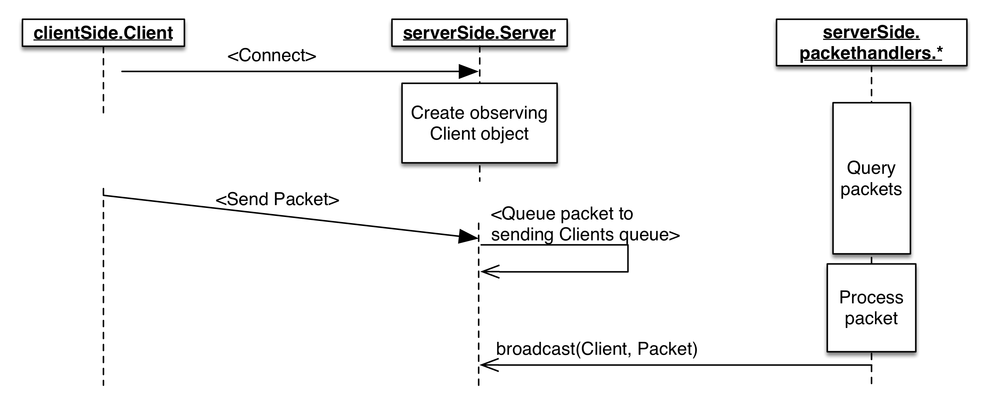
Client-Server Observer Pattern

Slide 3
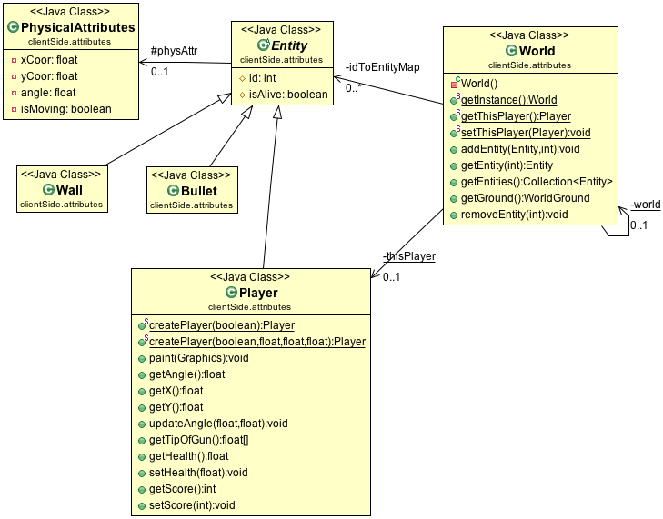
Singleton Pattern

Slide 4
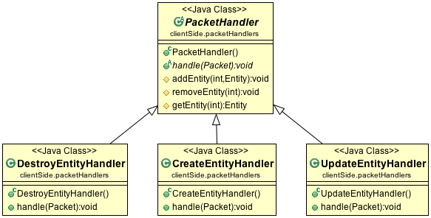
Command Pattern (Client)

Slide 5
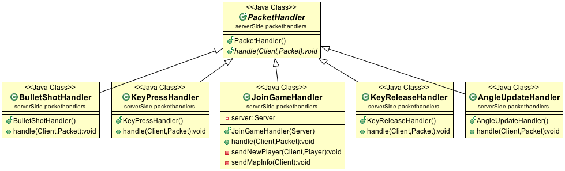
Command Pattern (Server)

Slide 6
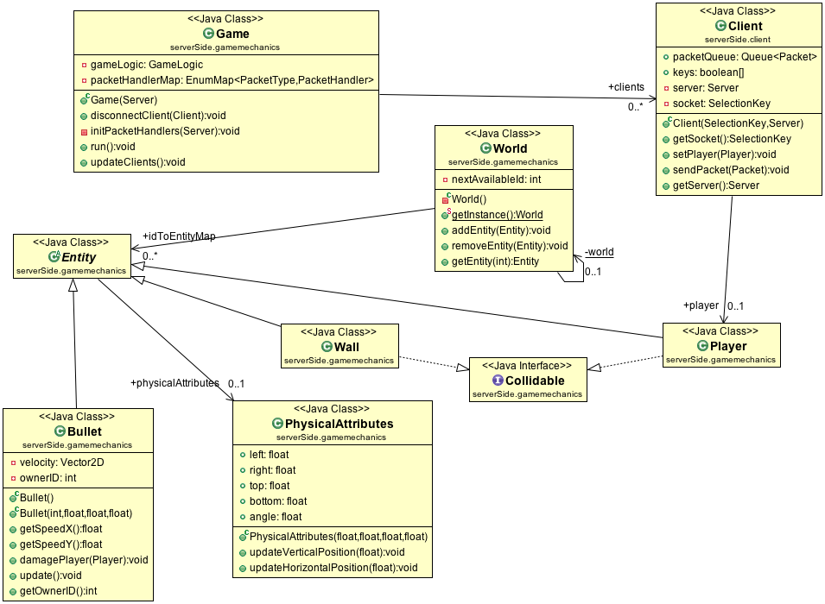
Singleton, Factory, Strategy, Observer

